Slide 1

Mini Project-2 (ID201B) Even Semester Session 2025-26
Online Book Store
Tushar Chandra Pant , Tushar Mishra , Shresth Yadav , Utkarsh Sanre
Project Supervisor:
Supervisor Name: Ms. Shruti Agarwal
Designation: Assistant Professor

Slide 2
Content
Introduction
Literature Review
Objective of the Project
Technology
Hardware Requirements
Software Requirements
Modules
Workflow
Reports
References
Notes:
Font Styles: Times New Roman + Font Size: 25

Slide 3
Introduction
Discover and Buy Your Next Favorite Read with Ease!
Our online bookstore makes it simple for book lovers to find and purchase their next great read. Whether you're into fiction, self-help, academic books, or bestsellers, our platform is designed to make book shopping effortless and enjoyable. With a user-friendly interface and a vast collection, we cater to all types of readers—from casual enthusiasts to passionate bibliophiles.
What We Offer:
📚 Extensive Book Collection – Explore a wide range of genres, from classic literature to modern bestsellers. 🎯 Personalized Recommendations – Get book suggestions based on your interests and reading history. 🛒 Easy and Secure Ordering – Enjoy a hassle-free shopping experience with secure payment options. 📖 E-books – Access digital versions for convenient reading on the go. ✍ Author Spotlights & Reviews – Read book reviews and discover new authors.
Notes:
Font Styles: Times New Roman + Font Size: 25

Slide 4
Literature Review
Online bookstores provide convenient access to books, with studies highlighting key factors influencing user experience and purchasing behavior.
User Preferences: Readers prefer easy navigation, clear categories, and personalized recommendations. Customer reviews significantly impact purchase decisions.
Book Information: Detailed descriptions, author bios, and reader reviews enhance user confidence in book selection.
Personalized Suggestions: AI-driven recommendations based on user history improve engagement and retention.
E-Books & Digital Trends: Demand for e-books and audiobooks is growing, with subscription models gaining popularity.
User Experience & Security: Mobile-friendly design and secure payment options increase trust and sales.
Notes:
Font Styles: Times New Roman + Font Size: 25

Slide 5
Objective of the Project
Objectives of an Online Bookstore
📖 Easy Book Discovery – Help users find books effortlessly with intuitive search and categorized collections. 📚 Comprehensive Information – Provide detailed book descriptions, author insights, and reader reviews. 🎯 Personalized Recommendations – Offer AI-driven suggestions based on user preferences and reading history. 🛒 Seamless Shopping Experience – Ensure a smooth, secure, and hassle-free book purchasing process. 📱 Multiple Formats – Offer print, e-books, and audiobooks to cater to different reading preferences. 📝 Reading Inspiration & Community – Share book reviews, recommendations, and author interviews to engage readers. 👥 Community Engagement – Create a platform for readers to share reviews, join discussions, and connect.
Notes:
Font Styles: Times New Roman + Font Size: 25

Slide 6
Technology (Hardware Requirements)
Minimum:
Processor: Intel i3
Memory: 8GB RAM,
Storage:500GB SSD or 500GB HDD.
Notes:
Font Styles: Times New Roman + Font Size: 25

Slide 7
Technology (Software Requirements)
﻿Technology Stack for Online Bookstore
💻 Code Editor: VS Code for writing and managing code efficiently. 🌐 Web Browser: Google Chrome or Firefox for testing and debugging the website. 🔄 Version Control:
Git for tracking changes.
GitHub for code storage and collaboration.
⚛ Frontend Development:
React.js for building a dynamic and responsive UI.
Tailwind CSS / Bootstrap for styling and responsive design.
🖥 Backend Development:
Node.js & Express.js for handling server-side logic.
MongoDB / PostgreSQL / MySQL for managing book and user data.
🛒 E-Commerce Integration:
Stripe / Razorpay / PayPal for secure online payments.
📦 Hosting & Deployment:
GitHub Pages for hosting static websites.
Vercel / Netlify for deploying React applications.
DigitalOcean / Heroku for backend hosting and APIs.
Notes:
Font Styles: Times New Roman + Font Size: 25

Slide 8
Modules
Modules for Online Bookstore
📌 1. Home Page
Overview of available books, bestsellers, and featured collections.
Promotional offers and new arrivals.
📚 2. Book Catalog
Browse books by categories (Fiction, Non-Fiction, Academic, etc.).
Search and filter options (genre, author, price, rating).
📖 3. Book Details Page
Detailed book descriptions, author information, and pricing.
Customer reviews and ratings.
🛒 4. Add to Cart Module
Add or remove books from the cart.
View cart summary before checkout.
🛍 5. Order Management
Secure checkout process with multiple payment options.
Order tracking and history for users.
👤 6. User Registration/Login
Account creation and login (Email/Google/Facebook).
Profile management with saved orders and wishlist.
🔐 7. User Authentication & Security
Password-protected user accounts.
Secure payments and transaction history.
Notes:
Font Styles: Times New Roman + Font Size: 25

Slide 9
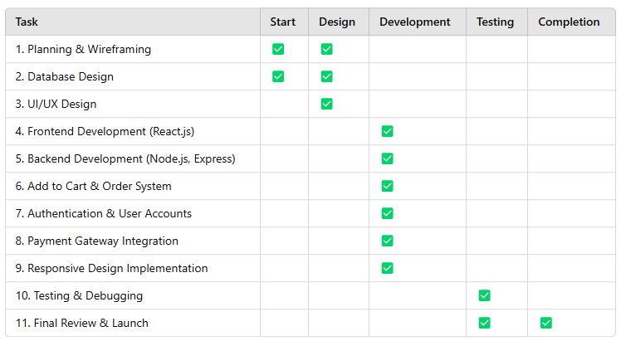
Workflow/Gantt Chart
Notes:
Font Styles: Times New Roman + Font Size: 25

Slide 10
Reports
Online Bookstore Website Report
1. Project Overview
Goal: Develop a user-friendly online bookstore for browsing, purchasing, and managing books. Audience: Book lovers, students, and general readers looking for easy online book shopping.
2. Key Features
📚 Book Catalog: Display books with categories, filters, and search options. 🛒 Shopping Cart & Checkout: Users can add books to the cart and complete purchases. 🔑 User Accounts: Registration/login for order tracking and personalized recommendations. 💳 Payment Gateway: Secure online payments via Stripe, Razorpay, or PayPal. ⭐ Reviews & Ratings: Users can review and rate books.
3. Technologies Used
Frontend: HTML, CSS, JavaScript, React.js (for dynamic UI). Backend: Node.js, Express.js, MongoDB (or MySQL/PostgreSQL). Authentication: Firebase/Auth0 for user login. Hosting & Deployment: GitHub, Vercel, Netlify for frontend; AWS/DigitalOcean for backend.
Notes:
Font Styles: Times New Roman + Font Size: 25

Slide 11
References
References
1. HTML & CSS
📌 W3Schools: HTML Tutorial 📌 W3Schools: CSS Tutorial
2. JavaScript & React
📌 MDN Web Docs: JavaScript Guide 📌 React Official Documentation
3. Backend Development
📌 Node.js Official Docs 📌 Express.js Guide 📌 MongoDB Documentation
4. Deployment & Hosting
📌 Vercel (For Frontend) 📌 Netlify (For Frontend)
📌 AWS (For Backend)
Notes:
Font Styles: Times New Roman + Font Size: 25

